Slide 1
INNOVATION & ENTREPRENEURSHIP
Dr. Astri Ghina
E-mail: astri.ghina24@gmail.com
Blog: aghina.staff.telkomuniversity.ac.id
Whatsapp: 082233887886
Line id: astri.ghina
Notes:
This template is in wide-screen format and demonstrates how transitions, animations, and multimedia choreography can be used to enrich a presentation.

Slide 2
PRA MID TEST
Introduction and course overview, The basic concepts of innovation, The basic concepts of entrepreneurship
The Entrepreneurial Process
The Concept of Intrapreneurship
The Global Entrepreneurial Revolution for Flatter World
The Entrepreneurial Mind: Crafting a Personal Entrepreneurial Strategy
UTS

Slide 3
AFTER MID TEST
Clean Commerce: Seeing opportunity through a sustainability lens
Innovation imperative; Organizing innovation and entrepreneurship
Network and systems; Innovative manufacturing
Individual Presentation
Individual Presentation
UAS

Slide 4
Course goal
By the end of this chapter you will develop an understanding of:
The basic concept of entrepreneurial process
The aspects of entrepreneurial process
The model of entrepreneurial process

Slide 5
Nature and development of entrepreneurship
Entrepreneur – An individual who takes initiative to bundle resources in innovative ways and is willing to bear the risk and/or uncertainty to act.
Entrepreneurial action - Behavior in response to a judgmental decision under uncertainty about a possible opportunity for profit.
The entrepreneurial process is a course of action that involves all functions, activities and actions associated with identifying and evaluating perceived opportunities and the bringing together of resources necessary for the successful formation of a new firm to pursue and seize the said opportunities (Bygrave, 1997:2; Cornwall & Naughton, 2003:62).

Slide 6
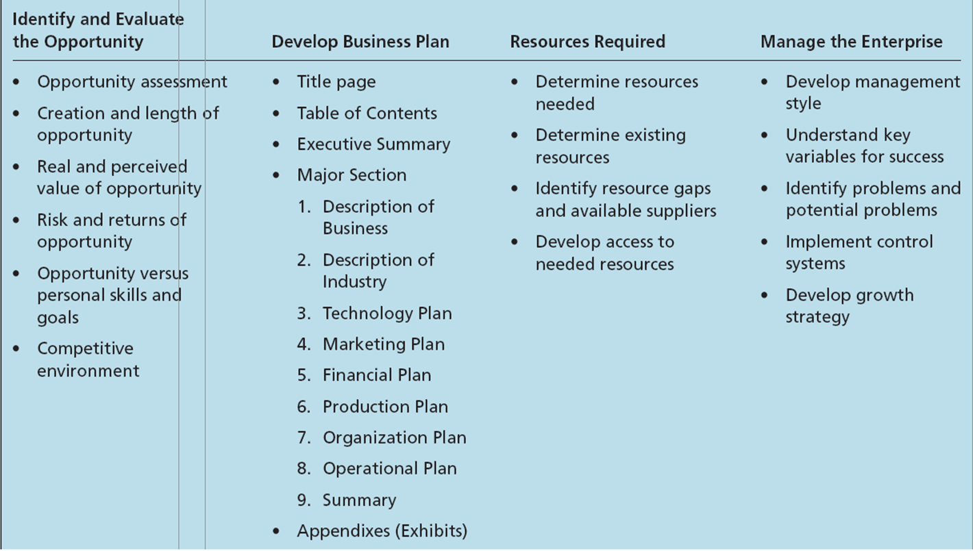
Aspects of entrepreneurial process Hisrich, et al. (2010)

Slide 7
Opportunity identification - The process by which an entrepreneur comes up with the opportunity for a new venture.
Window of opportunity - The time period available for creating the new venture.
Business plan - The description of the future direction of the business.

Slide 8
How entrepreneurs think
Entrepreneurs in particular situations may think differently when faced with a different task or decision environment.
Given the nature of their decision-making environment, entrepreneurs need to sometimes:
Effectuate vs. Causal
Be cognitively adaptable.
Learn from failure.

Slide 9
How entrepreneurs think
Causal process
Starts with a desired outcome.
Focuses on the means to generate that outcome.
Effectuation process
Starts with what one has (who they are, what they know, and whom they know).
Selects among possible outcomes.
Cognitive adaptability describes the extent to which entrepreneurs are:
Dynamic, flexible, self-regulating and engaged in the process of generating multiple decision frameworks focused on sensing and processing changes in their environments and then acting on them.

Slide 10
How entrepreneurs think
Learning from Business Failure
Uncertainty, changing conditions, and insufficient experience can contribute to failure among entrepreneurial firms.
Loss of a business can result in a negative emotional response from the entrepreneur. It can interfere with:
Entrepreneur’s ability to learn from the failure.
Motivation to try again.

Slide 11
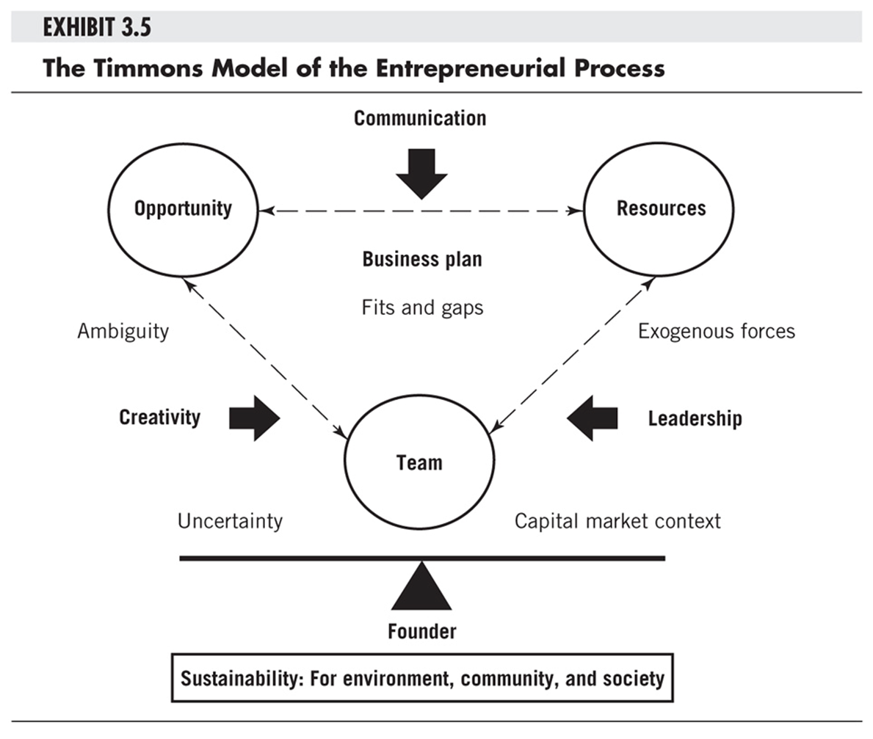

Slide 12
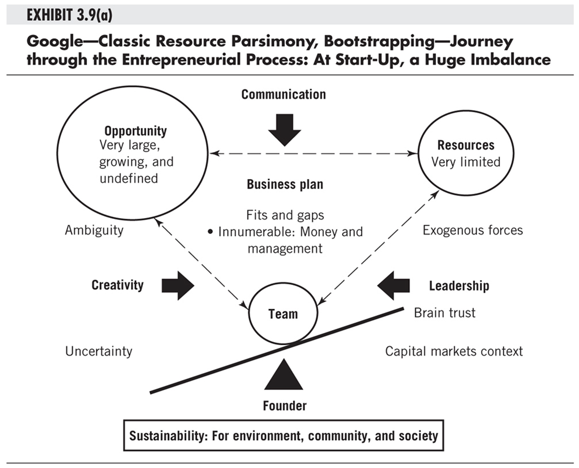

Slide 13
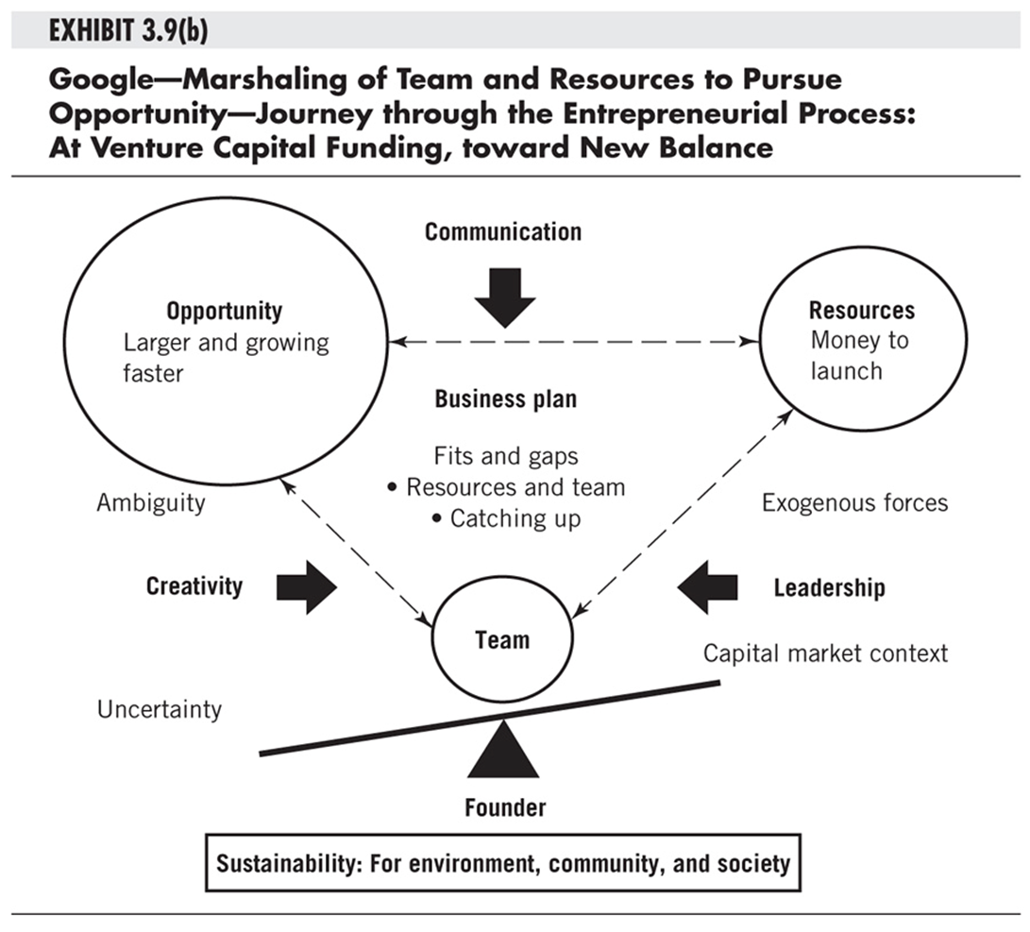

Slide 14
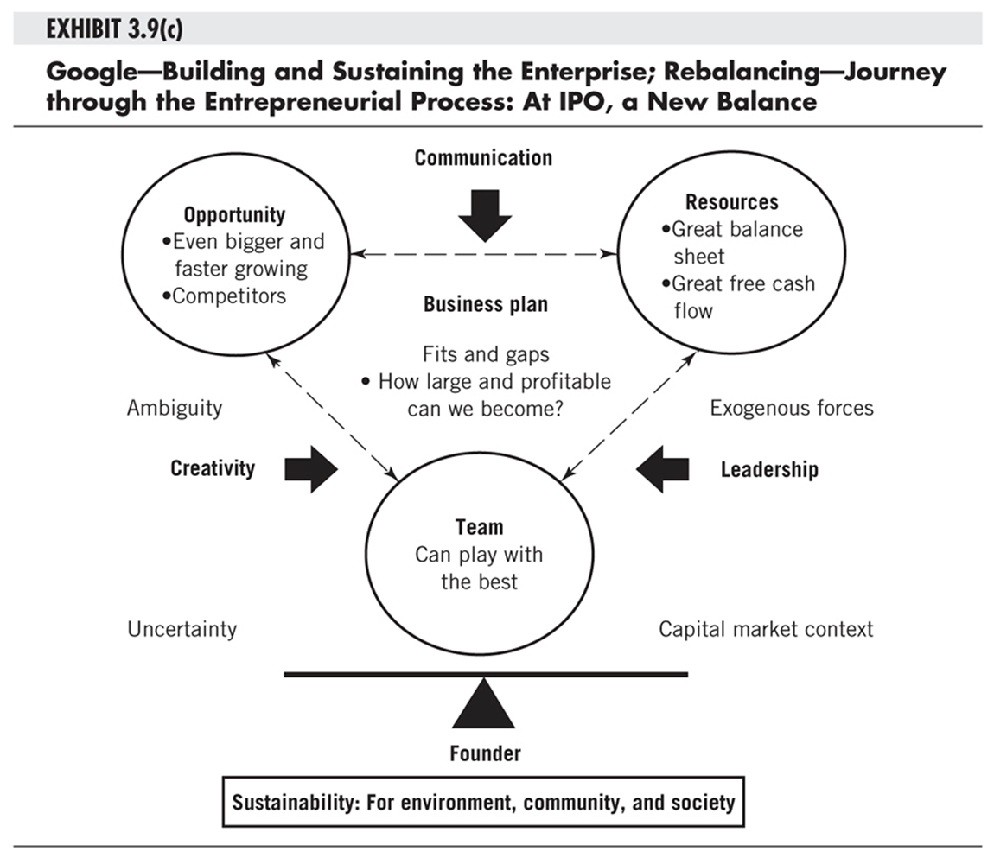

Slide 15
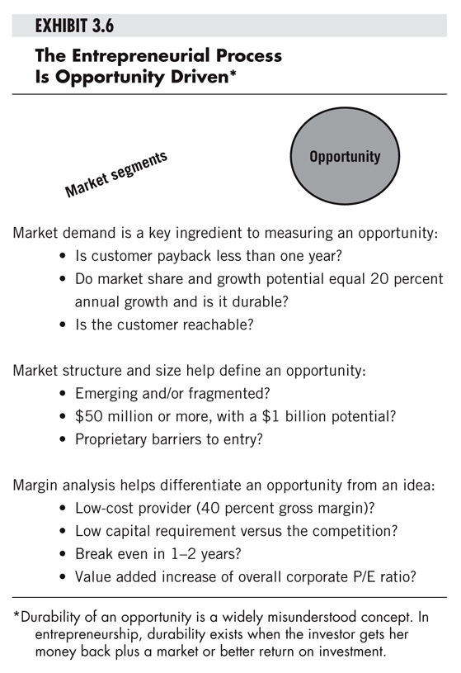
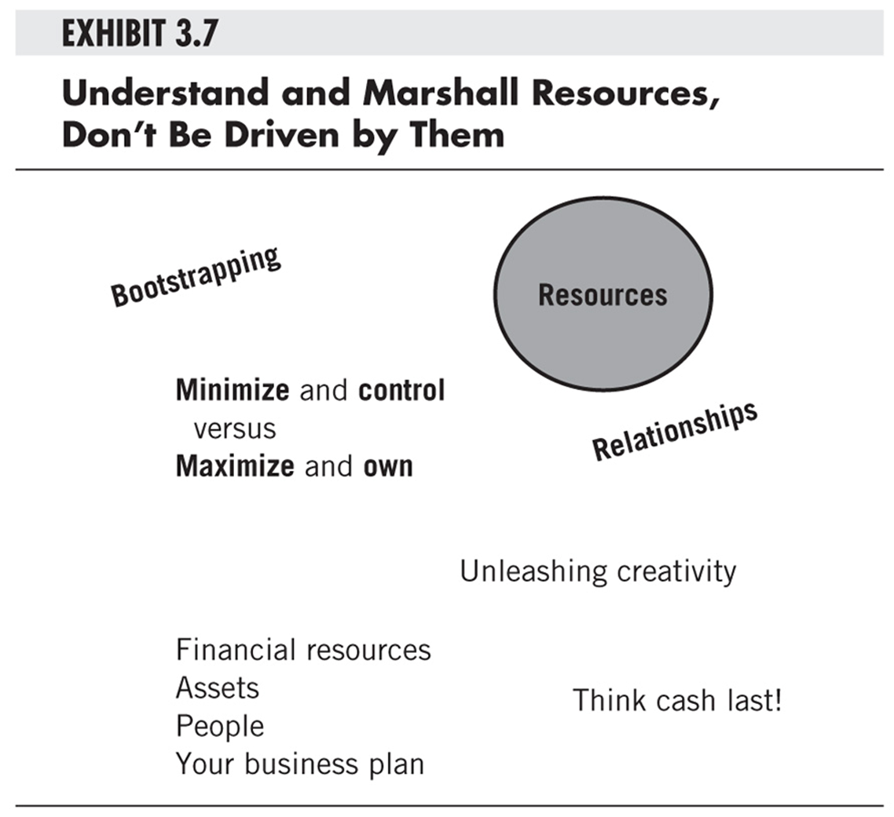

Slide 16
