Slide 1
KEWIRAUSAHAAN
Dr. Astri Ghina
E-mail: astri.ghina24@gmail.com
Blog: aghina.staff.telkomuniversity.ac.id
Whatsapp: 082233887886
Line id: astri.ghina
Notes:
This template is in wide-screen format and demonstrates how transitions, animations, and multimedia choreography can be used to enrich a presentation.

Slide 2
COURSE DESCRIPTION
Entrepreneurship course provides basic entrepreneurship concept which consist of business plan (market, operational, financial, finding innovative ideas). The students are given materials and assignments to train them in finding innovative ideas and can turn it into business opportunities.

Slide 3
What are your goals in this class?
Notes:
This slide can be used as a background before the presentation begins.

Slide 4
The goals
identify and capture the business opportunity
make innovation project based on previous observation within SMEs
identify and analyze the SWOT from SMEs
The students are capable to:

Slide 5
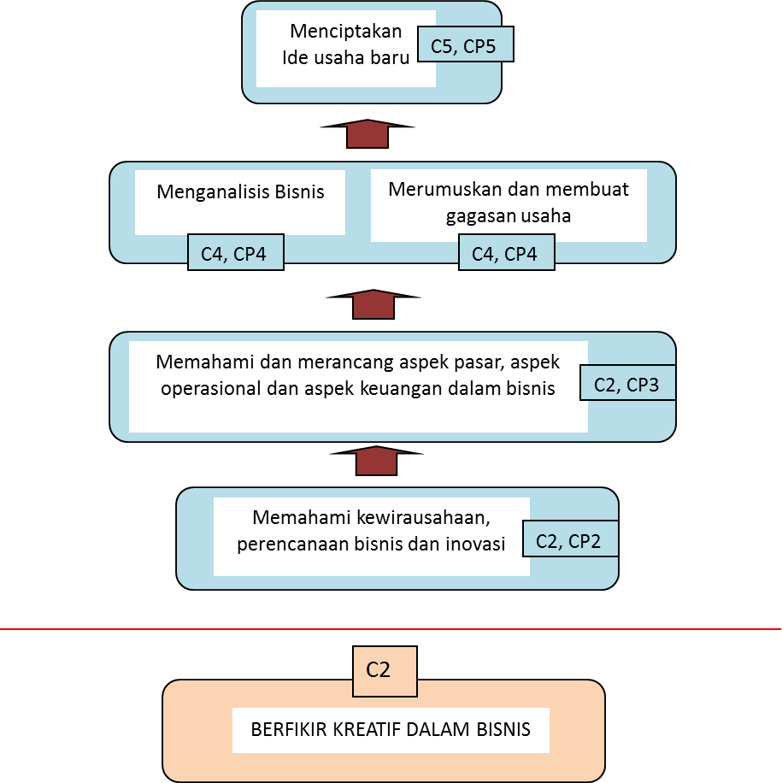
Mapping of course goals

Slide 6
CORRELATION WITH OTHER COURSES
BERFIKIR KREATIF DALAM BISNIS
KEWIRAUSAHAAN
PROYEK KEWIRAUSAHAAN

Slide 7
PRA MID TEST
Pengantar Kuliah Kewirausahaan
Pengantar Perencanaan bisnis dan Inovasi
Aspek Pasar
Aspek Operasional
Aspek Keuangan
Studi Lapangan
Studi Lapangan
UTS

Slide 8
AFTER MID TEST
Peluang Inovasi sesuai Keahlian (1)
Peluang Inovasi sesuai Keahlian (2)
Penjelasan Detil Proyek Inovasi/ Perencanaan bisnis
Pembuatan Inovasi/ Perencanaan bisnis
Pembuatan Inovasi/ Perencanaan bisnis
Presentasi Inovasi/ Perencanaan bisnis
Presentasi Inovasi/ Perencanaan bisnis
UAS

Slide 9
Group assignment
Determine SMEs as object study
Identify and analyze the Strength, Weakness, Opportunity, Threat (SWOT) based on product, operation, marketing, and financial aspects
Make proposal (innovative project planning) based on the findings from point (2)
Present your innovative idea

Slide 10
EVALUATION CRITERIA
THE DEGREE OF INNOVATION
COMPLETENESS OF ASSIGNMENT
PRESENTATION PERFORMANCE (including capability to handle Q&A)
PEER EVALUATION
UTS = 20%
UAS = 20%
PARTICIPATION = 20%
ASSIGNMENT = 40%

Slide 11
MAIN REFERENCE
Rhenald Kasali, dkk. 2010. Modul Kewirausahaan. Jakarta Selatan: Penerbit Hikmah.
SUPPORT REFERENCES
Bygrave, William; Zacharakis, Andrew. (2008), Entrepreneurship, John Wiley & Sons, Inc.
Hisrich, Robert D.; Peters, Michael P.; Shepherd, Dean A (2009), Entrepreneurship, 8th Edition, McGraw-Hill Higher Education.

Slide 12
THANK YOU
ANY QUESTIONS?

Slide 13
BECOMING ENTREPRENEUR

Slide 14
Course goal
By the end of this chapter you will develop an understanding of:
Basic terms of entrepreneurship
The importance of entrepreneur

Slide 15
Basic terms of entrepreneurship
Entrepreneurship
Entrepreneur
Intrapreneurship
Intrapreneur
Necessity Entrepreneur
Opportunity Entrepreneur

Slide 16
The importance of entrepreneur

Slide 19
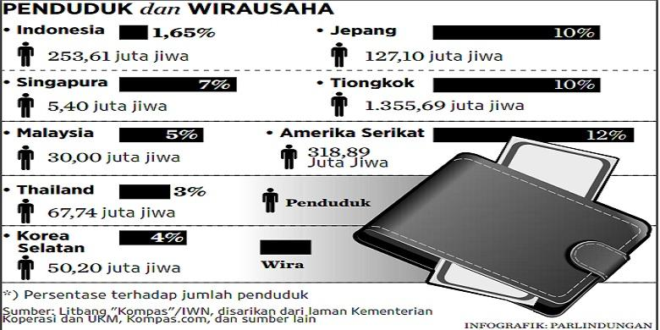

Slide 20
The importance of entrepreneur
Reduce unemployment particularly for educated unemployment
Improve the economic growth of nation

Slide 21
10 Ds The Most Important Characteristics of a successful entrepreneur by Bygrave
Dream/vision – having one and willingness to achieve
Decisiveness – ability to quickly & effectively make decisions
Doers – willingness to act not just talk/dream
Determination – firmness of purpose
Dedication – devoted to task/purpose
Devotion – loyalty, love of an activity/cause
Details – consider every aspect of the process
Destiny – set own goals & route to achieve
Dollars – Money/rich is only a measurement tools
Distribute – share with the key person to maintain

