Slide 1
INNOVATION & ENTREPRENEURSHIP
Dr. Astri Ghina
E-mail: astri.ghina24@gmail.com
Blog: aghina.staff.telkomuniversity.ac.id
Whatsapp: 082233887886
Line id: astri.ghina
Notes:
This template is in wide-screen format and demonstrates how transitions, animations, and multimedia choreography can be used to enrich a presentation.

Slide 2
PRA MID TEST
Introduction and course overview, The basic concepts of innovation, The basic concepts of entrepreneurship
The Entrepreneurial Process
The Concept of Intrapreneurship (Corporate Entrepreneurship)
The Global Entrepreneurial Revolution for Flatter World
The Entrepreneurial Mind: Crafting a Personal Entrepreneurial Strategy
UTS

Slide 3
AFTER MID TEST
Clean Commerce: Seeing opportunity through a sustainability lens
Innovation imperative; Organizing innovation and entrepreneurship
Network and systems; Innovative manufacturing
Individual Presentation
Individual Presentation
UAS

Slide 4
Course goal
By the end of this chapter you will develop an understanding of:
The basic concept of corporate entrepreneurship
How to establish corporate entrepreneurship in the organization
Corporate entrepreneurship assessment instrument

Slide 5
Corporate entrepreneurship
Term coined by Pinchot in 1982
Term “corporate entrepreneurship” used more today
Activities that receive organizational sanction and resource commitments for the purpose of innovative results.
A process whereby an individual or a group of individuals, in association with an existing organization, creates a new organization or instigates renewal or innovation within the organization.
A process that can facilitate firms’ efforts to innovate constantly and cope effectively with the competitive realities that companies encounter when competing in international markets

Slide 6
Corporate entrepreneurship
Interest in entrepreneurship within established businesses has intensified due to events occurring on:
Social.
Cultural.
Business levels.
Resistance against flexibility, growth, and diversification can, in part, be overcome by developing a spirit of entrepreneurship within the existing organization.
Increase in corporate entrepreneurship reflects an increase in social, cultural, and business pressures.

Slide 7
The need of corporate entrepreneurship
Rapid growth in the number of new and sophisticated competitors
Sense of distrust in the traditional methods of corporate management
An exodus of some of the best and brightest people from corporations to become small business entrepreneurs
International competition
Downsizing of major corporations
An overall desire to improve efficiency and productivity

Slide 8
Reengineering Corporate Thinking
Steps that will help innovative people to develop an entrepreneurial mindset:
Set explicit goals.
Create a system of feedback and positive reinforcement.
Emphasize individual responsibility.
Give rewards based on results.
Do not punish failures.

Slide 9
Entrepreneurial endeavour
Consist of the following four key elements:
New business venturing: corporate venturing; refers to creation of a new business within an existing organization.
Innovativeness: refers to product and service innovation, with emphasis on development and innovation in technology.
Self-renewal: transformation of an organization through renewal of the key ideas on which it is built.
Proactiveness: includes initiative and risk taking, competitive aggressiveness and boldness – particularly reflected in orientations and activities of top management.

Slide 10
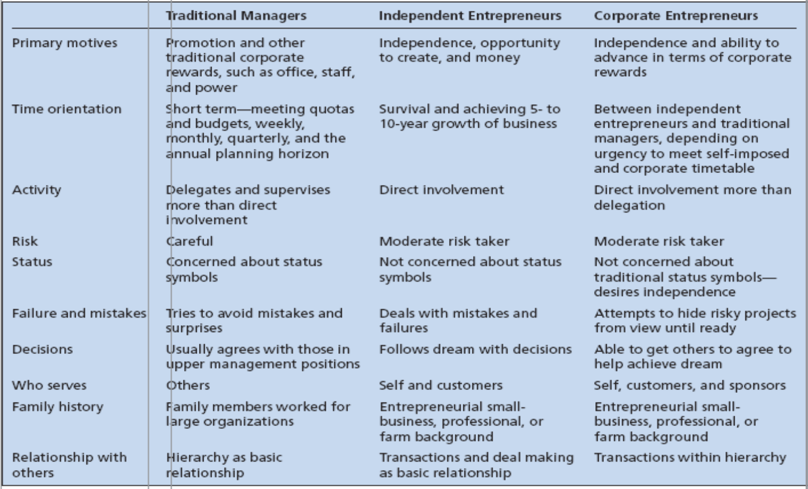
Comparison of Independent Entrepreneurs, Corporate Entrepreneurs, and Traditional Managers

Slide 11
Climate for Corporate Entrepreneurship
Organization operates on frontiers of technology.
New ideas encouraged.
Trial and error encouraged.
Failures allowed.
No opportunity parameters.
Resources available and accessible.
Multidiscipline teamwork approach.
Long time horizon.
Volunteer program.
Appropriate reward system.
Sponsors and champions available.
Support of top management.

Slide 12
Leadership Characteristics of Corporate Entrepreneurs
Understands the environment: Reflected in individual’s level of creativity.
Visionary and flexible.
Creates management options.
Encourages teamwork.
Encourages open discussion.
Builds a coalition of supporters.
Persistence.

Slide 13
Developing Individual Managers for Corporate Entrepreneurship
Corporate Entrepreneurship Training Program (Corporate Breakthrough Training)
The Breakthrough Experience
Breakthrough Thinking
Idea Acceleration Process
Barriers and Facilitators to Innovative Thinking
Sustaining Breakthrough Teams
The Breakthrough Plan

Slide 14
Establishing Corporate Entrepreneurship in the Organization
Step One:
Secure a commitment to corporate entrepreneurship in the organization by top, upper, and middle management levels.
Establish initial framework and embrace the concept.
Identify, select, and train corporate entrepreneurs.
Step Two:
Identify ideas and areas that top management is interested in supporting.
Identify amount of risk money available to develop the concept.
Establish overall program expectations and target results of each corporate venture.
Establish mentor/sponsor system.
Step Three: use of technology to ensure organizational flexibility.
Step Four: Identify interested managers to train employees and share their experiences.

Slide 15
Step Five: Develop ways for organization to get closer to its customers.
Step Six: Learn to be more productive with fewer resources.
Step Seven: Establish a strong support structure for corporate entrepreneurship.
Step Eight: Involve tying rewards to the performance of the entrepreneurial unit.
Finally: Implement an evaluation system that allows successful entrepreneurial units to expand and unsuccessful ones to be eliminated.

Slide 16
Corporate Entrepreneurship Assessment Instrument (CEAI)
Key Internal Climate Factors in an Organization’s Readiness for Entrepreneurial Activity
Management support
Autonomy/work discretion
Rewards/reinforcement
Time availability
Internal organizational boundaries

Slide 17
Problems and Successful Efforts
A study found that new ventures started within a corporation performed worse than those started independently by entrepreneurs.
Reasons cited:
Corporation’s difficulty in maintaining a long-term commitment.
A lack of freedom to make autonomous decisions.
A constrained environment.

Slide 18
On average, independents become:
Profitable twice as fast.
End up twice as profitable.
Examples of companies that have adopted their own version of the implementation process to launch new ventures successfully:
Minnesota Mining and Manufacturing (3M).
Hewlett-Packard (HP).
IBM.

Slide 19
Corporate Innovator’s Commandments
Come to work each day willing to give up your job for the innovation.
Circumvent any bureaucratic orders aimed at stopping your innovation.
Ignore your job description, do any job needed to make your innovation work.
Build a spirit innovation team that has the “fire” to make it happen.
Keep your innovation “underground” until it is prepared for demonstration to the corporate management.
Find a key upper level manager who believes in you and your ideas and will serve as a sponsor to your innovation.
Permission is rarely granted in organizations, thus always seek forgiveness for the “ignorance” of the rules that you will display.
Always be realistic about the ways to achieve the innovation goals.
Share the glory of the accomplishments with everyone on the team.
Convey the innovation’s vision through a strong venture plan.

