Slide 1
INNOVATION & ENTREPRENEURSHIP
Dr. Astri Ghina
E-mail: astri.ghina24@gmail.com
Blog: aghina.staff.telkomuniversity.ac.id
Whatsapp: 082233887886
Line id: astri.ghina
Notes:
This template is in wide-screen format and demonstrates how transitions, animations, and multimedia choreography can be used to enrich a presentation.

Slide 2
PRA MID TEST
Introduction and course overview, The basic concepts of innovation, The basic concepts of entrepreneurship
The Entrepreneurial Process
The Concept of Intrapreneurship
The Global Entrepreneurial Revolution for Flatter World
The Entrepreneurial Mind: Crafting a Personal Entrepreneurial Strategy
UTS

Slide 3
AFTER MID TEST
Clean Commerce: Seeing opportunity through a sustainability lens
Innovation imperative; Organizing innovation and entrepreneurship
Network and systems; Innovative manufacturing
Individual Presentation
Individual Presentation
UAS

Slide 4
Course goal
By the end of this chapter you will develop an understanding the transformation and revolution of entrepreneurship

Slide 5
Entrepreneurship Flattens the World
Adoption of the entrepreneurial mind-set is growing exponentially larger and faster

Slide 6
Entrepreneurship Around the Globe
A 2000 EU Economic Action Plan calls for:
Fueling entrepreneurial mind-sets
Encouraging more people to become entrepreneurs
Gearing entrepreneurs for growth and competitiveness
Improving the flow of finance
Creating a more entrepreneurial-friendly regulatory and administrative framework

Slide 7
Four Entrepreneurial Transformations
That are Changing the World
Entrepreneurship is the new management paradigm for thinking and reasoning.
Entrepreneurship has spawned a new education paradigm for learning and teaching.
Entrepreneurship is becoming a dominant management model for running nonprofit businesses and social ventures.
Entrepreneurship is transcending business schools.

Slide 8
Innovation + Entrepreneurship = Prosperity and Philanthropy
Entrepreneurship is an important political phenomenon.
The linkage between entrepreneurship and public policy is increasingly important.

Slide 9
Job Creation
Landmark Research findings by David Birch of MIT
New firms created 81.5 percent of the net new jobs from 1969 to 1976.
According to the U.S. Small Business Administration’s Office of Advocacy, in 2004 small firm with fewer than 500 employees represented 99.9 percent of the 26.8 million businesses in the United States.

Slide 10
New Venture Formation
Creates economic and social mobility
Is opportunity-centered and rewards talent and performance
Entrepreneurship is not about religion, gender, skin color, social class, or national origin
Women and a number of ethnic and racial groups are excelling at entrepreneurship

Slide 11
Examples of Mega-Entrepreneurs Who Started in Their 20s
Microsoft—Bill Gates and Paul Allen
Dell Computers—Michael Dell
Apple Computers—Steve Jobs and Steve Wozniak
Federal Express—Fred Smith
Polaroid—Edward Land
Nike—Phil Knight

Slide 12
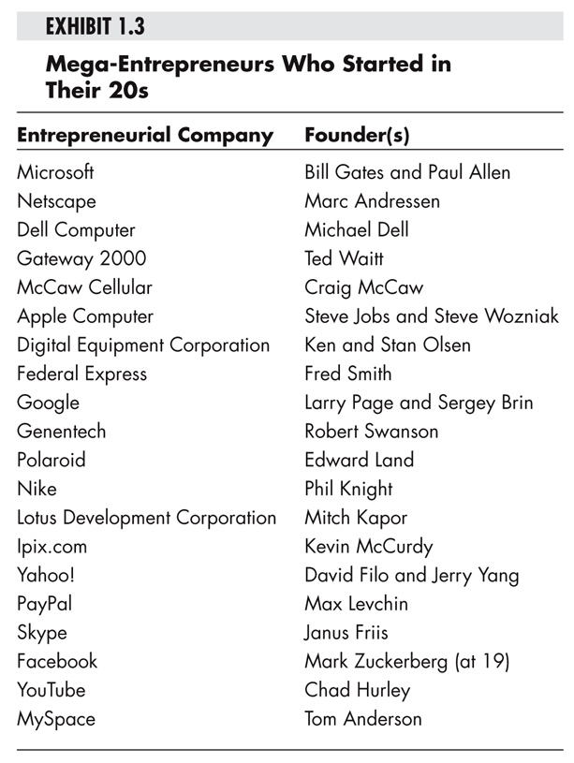

Slide 13
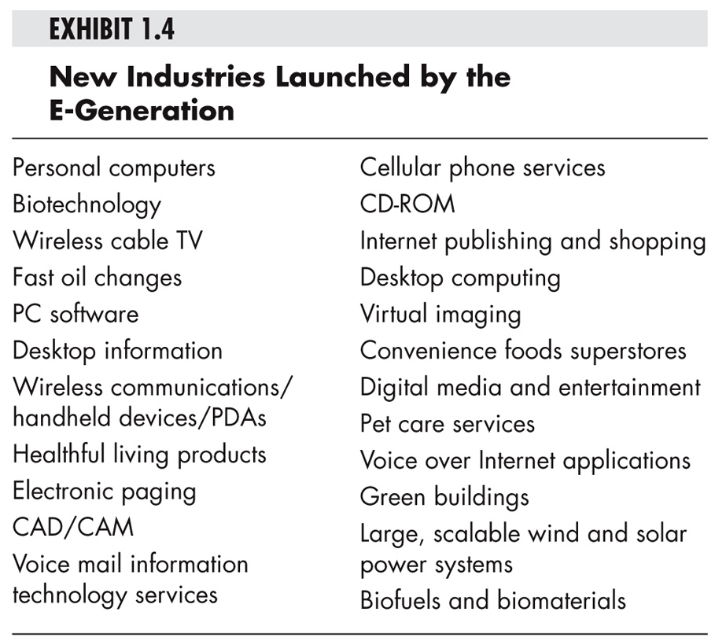

Slide 14
Angel Investors
Moderately wealthy to very wealthy individuals
Successful entrepreneurs
Bring experience, learning curves, networks, wisdom and maturity
Serve as coach, confidant, mentor and cheerleader

Slide 15
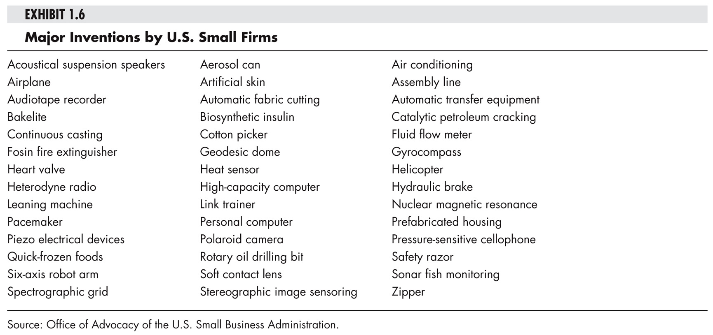

Slide 16
Philanthropy and Leadership
Successful entrepreneurs give back to the community
Colleges and universities
New buildings, classrooms, athletic facilities, and endowed professorships
The largest gifts and the greatest proportion of donors to college capital campaigns
Local churches, hospitals, museums, orchestras, and schools

Slide 17
The Entrepreneurial Revolution
Entrepreneurship is:
Taught at over 2,000 colleges, universities, and community colleges.
The focus of a number of educational grants.
Creates most of the net new jobs nationwide.
Self-employment eliminates “glass ceilings” and “glass walls” for women and minorities.
Gaining and growing in elementary through high schools.

Slide 18
Building an Entrepreneurial Society
The poor get richer
Equal opportunities (not equal incomes) are created
Economic mobility increases
Social mobility increases

