Slide 1
INNOVATION & ENTREPRENEURSHIP
Dr. Astri Ghina
E-mail: astri.ghina24@gmail.com
Blog: aghina.staff.telkomuniversity.ac.id
Whatsapp: 082233887886
Line id: astri.ghina
Notes:
This template is in wide-screen format and demonstrates how transitions, animations, and multimedia choreography can be used to enrich a presentation.

Slide 2
PRA MID TEST
Introduction and course overview, The basic concepts of innovation, The basic concepts of entrepreneurship
The Entrepreneurial Process
The Concept of Intrapreneurship
The Global Entrepreneurial Revolution for Flatter World
The Entrepreneurial Mind: Crafting a Personal Entrepreneurial Strategy
UTS

Slide 3
AFTER MID TEST
Clean Commerce: Seeing opportunity through a sustainability lens
Innovation imperative; Organizing innovation and entrepreneurship
Network and systems; Innovative manufacturing
Individual Presentation
Individual Presentation
UAS

Slide 4
Course goal
By the end of this chapter you will develop an understanding:
The basic concept of crafting a personal entrepreneurial strategy
The critical aspects of the entrepreneurial mind—the strategies, habits, attitudes, and behaviors that work for entrepreneurs who build higher-potential ventures.

Slide 5
Achieving Entrepreneurial Greatness
Three core principles of Marion Labs and the Kauffman Foundation:
Treat others as you would want to be treated
Share the wealth that is created with all those who have contributed to it at all levels
Give back to the community

Slide 6
Leadership and Human Behavior
A single psychological model of entrepreneurship has been supported by research
But, behavioral scientists, venture capitalists, investors, and entrepreneurs agree the venture will depend a great deal upon the talent and behavior of the lead entrepreneur and his or her team
Myths still exist about entrepreneurs and entrepreneurship

Slide 7
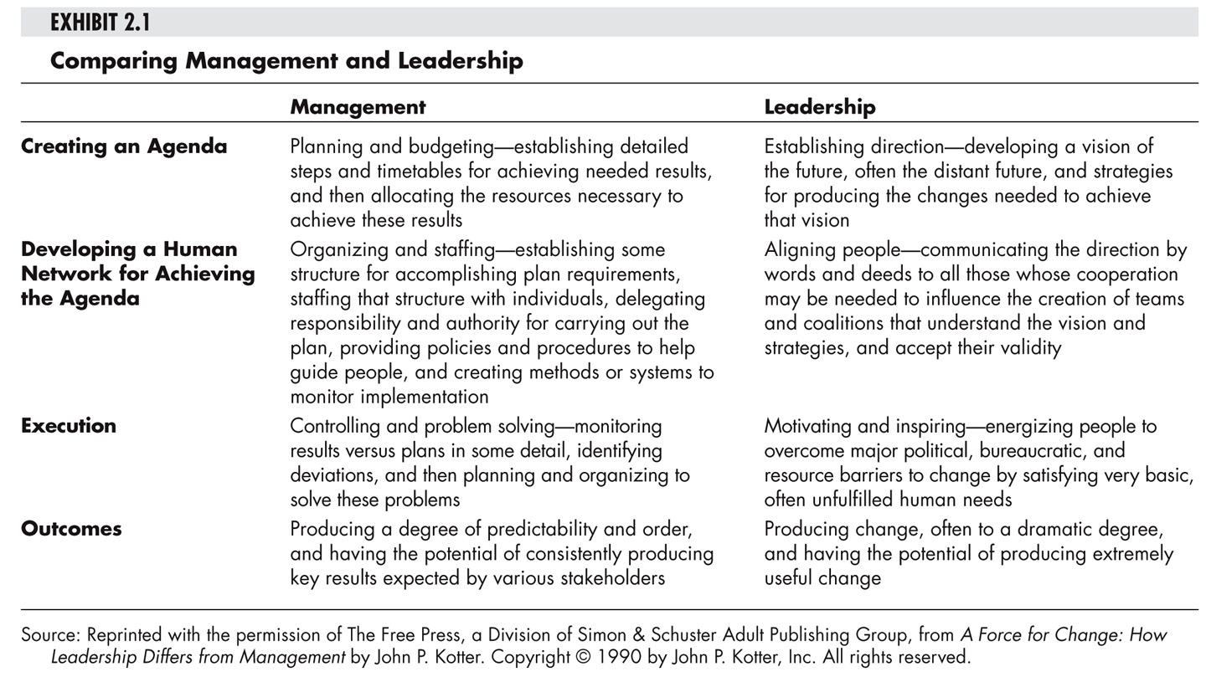

Slide 8
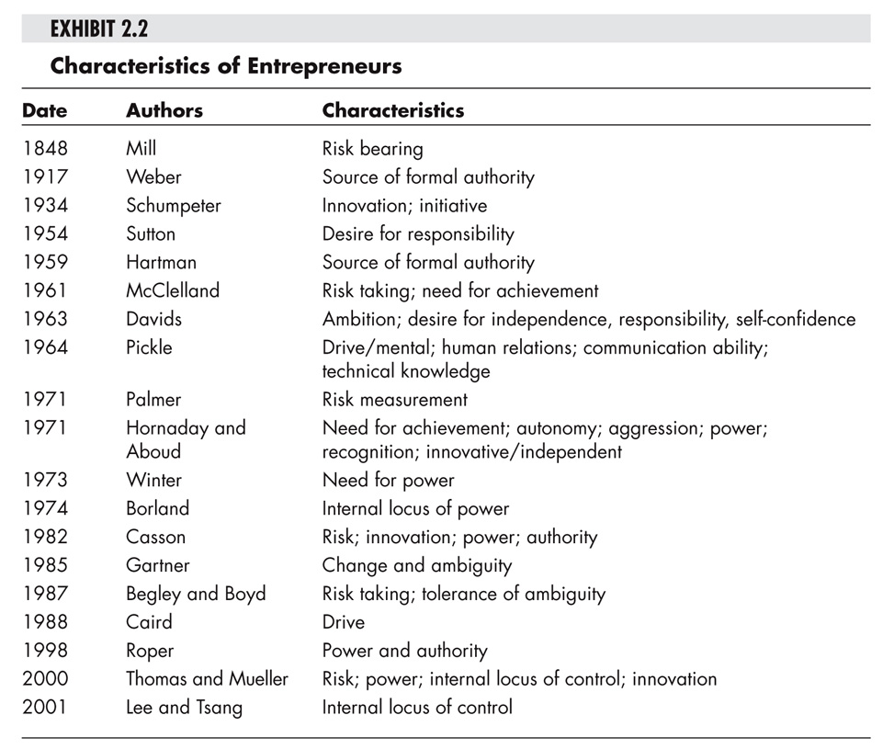

Slide 9
Converging on the Entrepreneurial Mind
Desirable and Acquirable Attitudes, Habits and Behaviors
Seven Dominant Themes
Commitment and Determination
Courage
Leadership
Opportunity Obsession
Tolerance of Risk, Ambiguity and Uncertainty
Creativity, Self-Reliance, and Adaptability
Motivation to Excel

Slide 10
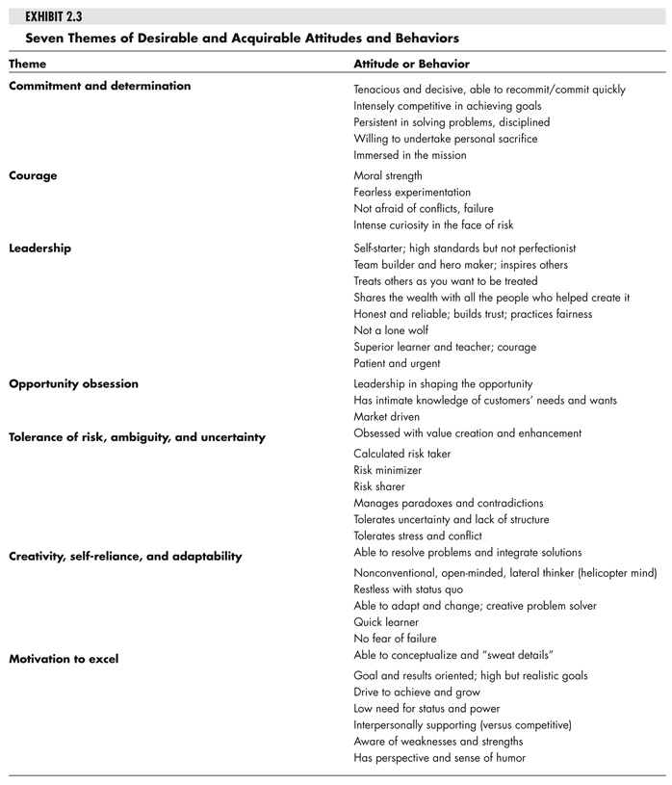

Slide 11
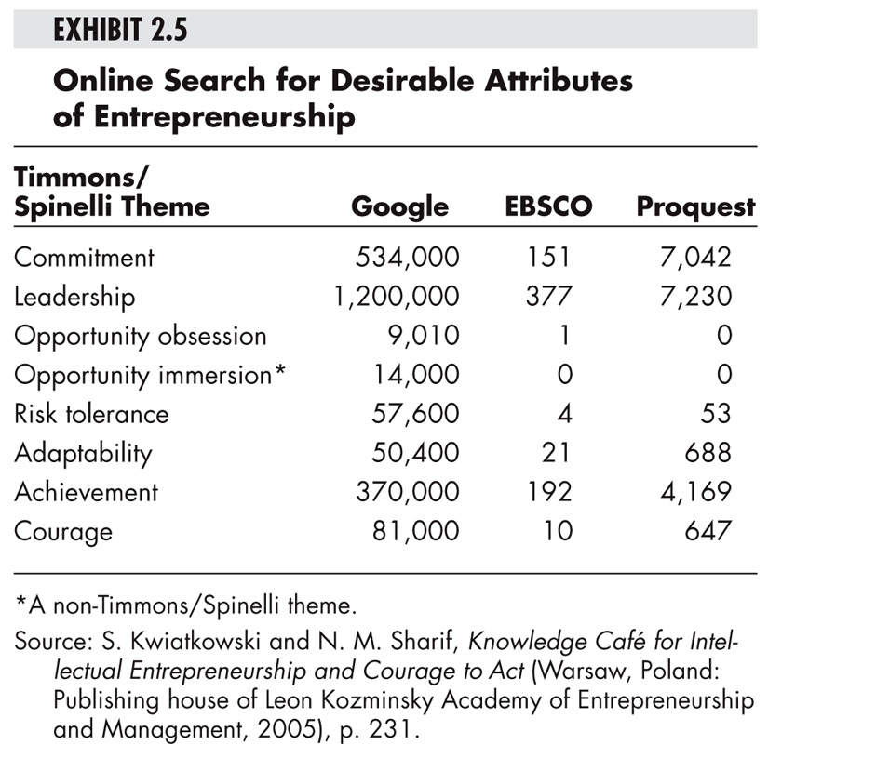

Slide 12
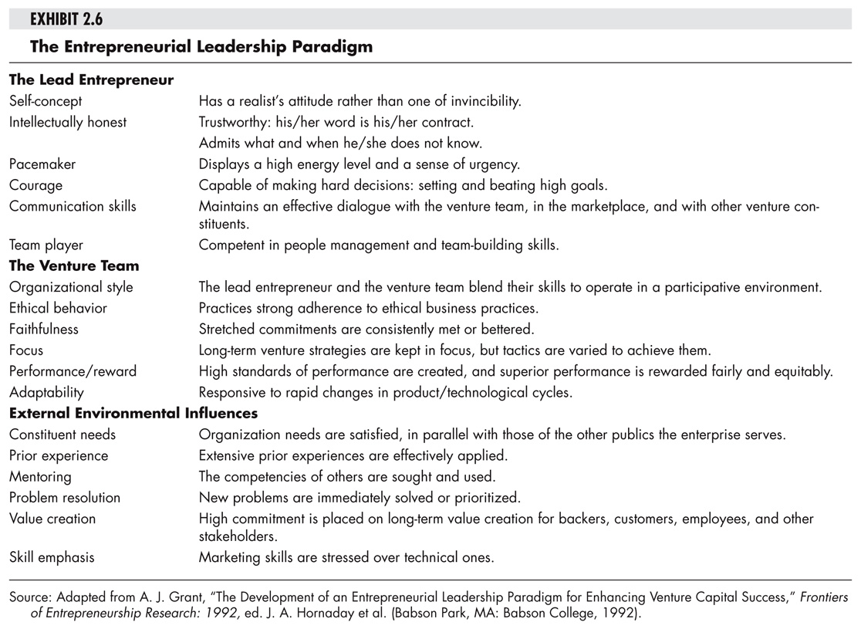

Slide 13
The Entrepreneurial Mind in Action
Successful entrepreneurs have a wide range of personality types
Research has considered genetics, family, education, career experience, etc., but no psychological model of entrepreneurship has been supported.
Acquired skills are more important that specific inherent traits

Slide 15
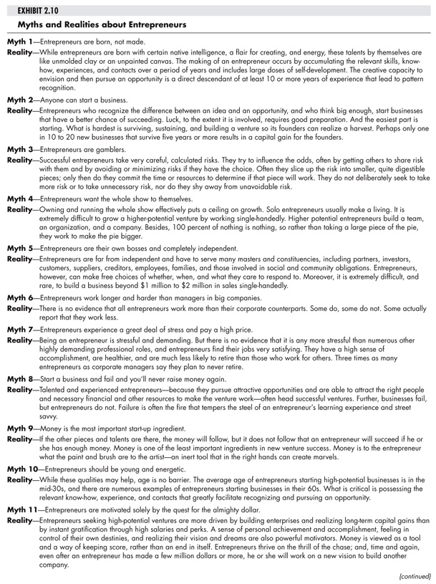

Slide 16
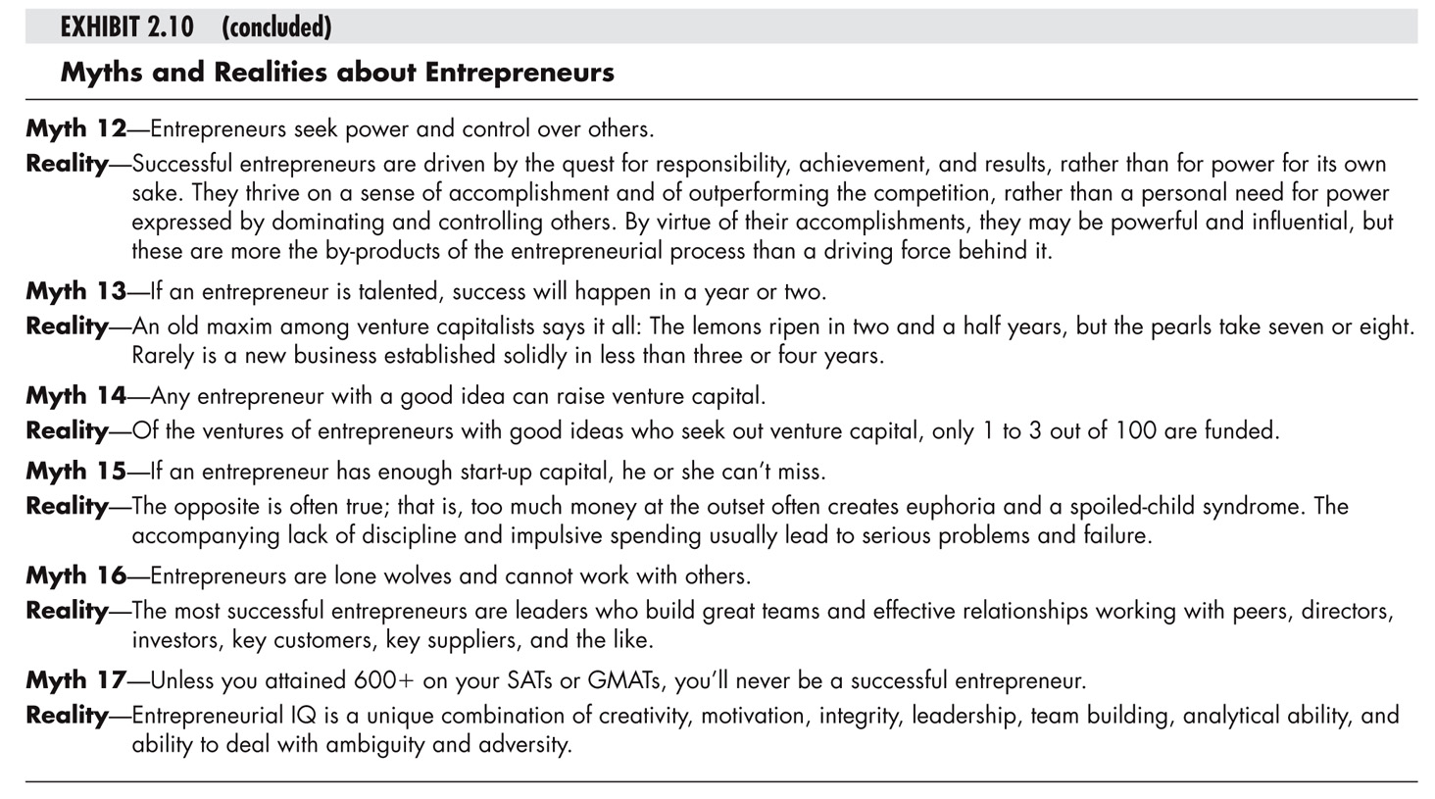

Slide 17
Myth #1
It takes a lot of money to finance a new business.
Not true. The typical start-up only requires about $25,000 to get going. The successful entrepreneurs who don’t believe the myth design their businesses to work with little cash. They borrow instead of paying for things. They rent instead of buy. And they turn fixed costs into variable costs by, say, paying people commissions instead of salaries.
From Scott Shane “The Illusions of Entrepreneurship” 2008

Slide 18
Myth #2
Start-ups can’t be financed with debt.
Actually, debt is more common than equity. According to the Federal Reserve’s Survey of Small Business Finances, fifty-three percent of the financing of companies that are two years old or younger comes from debt and only forty-seven percent comes from equity. So a lot of entrepreneurs out there are using debt rather than equity to fund their companies.

Slide 19
Myth #3
Banks don’t lend money to start-ups.
This is another myth. Again, the Federal Reserve data shows that banks account for sixteen percent of all the financing provided to companies that are two years old or younger.
While sixteen percent might not seem that high, it is three percent higher than the amount of money provided by the next highest source – trade creditors – and is higher than a bunch of other sources that everyone talks about going to: friends and family, business angels, venture capitalists, strategic investors, and government agencies.

Slide 20
Myth #4
The growth of a start-up depends more on an entrepreneur’s talent than on the business he chooses.
Sorry to deflate some egos here, but the industry you choose to start your company has a huge effect on the odds that it will grow.
The odds that you will make the Inc 500 are 840 times higher if you start a computer company than if you start a hotel or motel. There is nothing anyone has discovered about the effects of entrepreneurial talent that has a similar magnitude effect on the growth of new businesses.

Slide 21
Myth #5
Most entrepreneurs are successful financially.
Sorry, this is another myth. Entrepreneurship creates a lot of wealth, but it is very unevenly distributed.
The typical profit of an owner-managed business is $39,000 per year.
Only the top ten percent of entrepreneurs earn more money than employees.
And the typical entrepreneur earns less money than he otherwise would have earned working for someone else.

Slide 22
Myth #6
Starting a business is easy.
Actually it isn’t, and most people who begin the process of starting a company fail to get one up and running. Seven years after beginning the process of starting a business, only one-third of people have a new company with positive cash flow greater than the salary and expenses of the owner for more than three consecutive months.

Slide 23
Crafting a Personal Entrepreneurial Strategy
A Conceptual Scheme for Self Assessment
Crafting an Entrepreneurial Strategy
Profiling the Past
Profiling the Present
Getting Constructive Feedback
Putting it all Together
Thinking Ahead

Slide 24
Personal Entrepreneurial Strategy
Gather data both from yourself (past and present profiles)
Gather data from others (constructive feedback)
Evaluate the data you have
Think ahead
Craft your personal entrepreneurial strategy
Estimated time to complete this important planning and goal setting exercise is 90 minutes to three hours

