Slide 1
Seminar proposal
Dr. Astri Ghina
E-mail: mmregular@gmail.com
Blog: aghina.staff.telkomuniversity.ac.id
Whatsapp: 082233887886
Line id: astri.ghina
Notes:
This template is in wide-screen format and demonstrates how transitions, animations, and multimedia choreography can be used to enrich a presentation.

Slide 2
PRA MID TEST
Berbagai Paradigma yang Bersaing dalam Penelitian Kualitatif (Bab 6)
Desain Penelitian Kualitatif (Bab 12)
Studi Kasus (Bab 14)
Etnografi dan Observasi Partisipan; Metodologi Grounded Theory (Bab 15 & 16)
Metode Pengumpulan dan Analisis Data-Data Empiris (Bab 23-27)
UTS

Slide 3
AFTER MID TEST
Manajemen Data dan Metode Analisis (Bab 28)
Analisis Naratif, Analisis Konten, dan Analisis Semiotik (Bab 29)
Kriteria untuk Menilai Validitas Interpretif dalam Penelitian Kualitatif (Bab 30)
Mentoring & Individual Presentasi
Mentoring & Individual Presentasi
UAS

Slide 4
Course goal
By the end of this chapter you will develop an understanding of:
To plan a qualitative study on the certain topic
To cover some basic ideas about qualitative research
To introduce you to the idea of “types” of qualitative research

Slide 5
WHAT IS QUALITATIVE RESEARCH ?
Qualitative research is an inquiry approach in which the inquirer:
Explores a central phenomenon (one key concept)
Asks participants broad, general questions
Collects detailed views of participants in the form of words or images
Analyzes and codes the data for description and themes
Interprets the meaning of the information drawing on personal reflections and past research
Writes the final report that includes personal biases and a flexible structure.
(adapted from Creswell 2002, p. 58)

Slide 6
RESEARCH TOPIC AND RESEARCH PROBLEM
Identify the subject area or topic for the study
Specify the research problem: The practical issue that leads to a need for your study.
Complete these sentences:
“The topic for this study will be…”
“This study needs to be conducted because…”

Slide 7
A GOOD QUALITATIVE PURPOSE STATEMENT
It includes:
Single sentence
“The purpose of this study . . .”
Central phenomenon
Qualitative words (e.g. “explore,” “understand,” “discover”)
Participants
Research site

Slide 8
A good sample of purpose statement
“The purpose of this qualitative study (replace later with type of qualitative tradition) will be to ______(understand, describe, develop, discover) the ________(central focus) for _______(participants: person, process, groups) at ______________(site)."

Slide 9
UNDERSTANDING THE CENTRAL PHENOMENON
QUANTITATIVE
QUALITATIVE
influences
X
Y
Y
Independent
Variable
Dependent
Variable
Central Phenomenon

Slide 10
Let’s stay away from quantitative language that might mislead readers
What is not included in this statement:
Not a comparison
Not relating variables
Not proving hypotheses
Not measuring variables

Slide 11
Writing good qualitative research questions
Questions narrow the purpose
Two types:
Central question: the most general question you could ask
Sub questions
Sub-divides central question into more specific topics questions
Limited number

Slide 12
A good sample of research question
Central Question Script: (usually write only one)
“What does it mean to ______________ (central phenomenon)?”
“How would _________ (participants) describe __________ (central phenomenon)?"
Sub-Question Script:
“(What) ______________ (aspect) does ______ (participant) engage in as a _____________ (central phenomenon)?”

Slide 13
Use good qualitative wording for these questions
Begin with words such as “how,” “what,”
Tell the reader what you are attempting to “discover,” “generate,” “explore,” “identify,” or “describe”
Ask “what happened?” to describe
Ask “What was the meaning to people of what happened?” to understand
Ask “What happened over time?” to explore a process

Slide 14
Avoid word such as:
“relate”
“influence”
”impact”
“effect”
“cause”

Slide 15
The strategy of qualitative research
Phenomenology
Ethnography
Grounded Theory
Case Study

Slide 16
Qualitative research design
The qualitative strategy that used in this research
Data collection
Data analysis
Data representation
Data interpretation
Data validation

Slide 17
The strategy of qualitative research
DIMENSION | NARRATIVE | PHENOMENOLOGY | GROUNDED THEORY | ETHNOGRAPHY | CASE STUDY
Focus | •Exploring the life of an individual | • Understanding the essence of experiences about a phenomenon | • Developing a theory grounded from data in the field | • Describing and interpreting a cultural or social group | • Developing an in-depth analysis of a single case or multiple cases
Data Collection | • Primary interviews and documents | • Long interviews with up to 10 people | • Interviews with 20-30 individuals to “saturate” categories and detail a theory | • Primarily observations and interviews with additional artifacts during extended time in the field (e.g. 6 months to a year) | • Multiple sources including documents, archival records, interviews, observations, • Physical artifacts
Data Analysis | • Stories • Epiphanies • Historical content | • Statements • Meanings • Meaning themes • General description of the experience | • Open coding • Axial Coding • Selective Coding • Conditional Matrix | • Description • Analysis • Interpretation | • Description • Themes • Assertions
Narrative Form | • Detailed picture of an individual’s life | • Description of the “essence” of the experience | • Theory or theoretical model | • Description of the cultural behavior of a group or an individual | • In-depth study of a “case” or “cases”

Slide 18
select the qualitative strategy for our study
Choose a qualitative research strategy for our research problem.
Tell why we chose it and how it relates to the study’s purpose.

Slide 19
then, what data will be collected?
Who will be studied?
What information will be collected?

Slide 20
Criteria for selecting people / site
Can the people and sites help us learn about our central phenomenon? (purposefully select people and sites)
How many people and sites should we study? (keep sample size small)
Do we have access? (gain access)
Do we have permissions (obtain permissions)

Slide 21
What types of information can be collected in qualitative research?
Observations
Interviews
Documents
Audio-Visual Materials

Slide 22
If we choose to observe, how do we do it?
Create an observational protocol
Record descriptive notes
Record reflective notes
Decide on your observational stance
Enter site slowly
Conduct multiple observations
Summarize at end of each observation

Slide 23
If we choose to observe, how do we interview?
Decide on the type of interview to use
Individual
Focus group
Telephone
e-mail
Create an interview protocol
Ask open-ended questions (5-7)
Allows the participant to create options for responding
Participants can voice their experiences and perspectives
If possible, tape record and transcribe for analysis

Slide 24
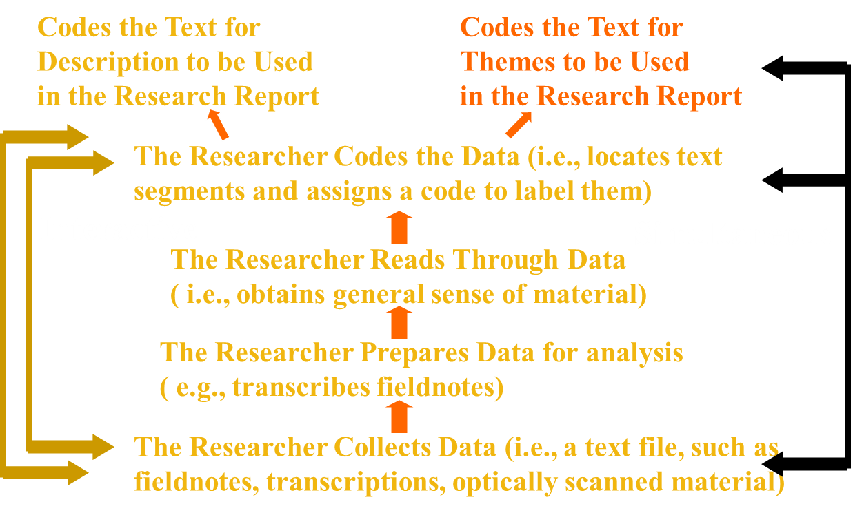
Once we collect the data, how will we analyze it? The overall process

Slide 25
More specific steps in the analysis process
Exploring the database
Coding the data
Developing findings - a description and themes
(Re) presenting the description and themes
Interpreting the findings
Validating the findings

Slide 26
How do we first explore the database?
Obtain a general sense of the data
Write down memos on hard copy
Think about the organization of the data
Consider whether more data are needed

Slide 27
How will we report our findings? (What topics do we present in the findings?)
We might describe the setting
We might identify and discuss 5-7 themes (including multiple perspectives, good quotes, useful dialogue, even metaphors or analogies)
We write in detail
We try to make the narrative as realistic as possible (even note tensions/contradictions)
We report the narrative in a way consistent with our tradition
Narrative – typically a chronology
Phenomenology – typically description building toward the essence of the phenomenon
Ethnography – description of the setting and cultural themes that display the way culture-sharing works
Grounded theory – categories of information leading to a theoretical model
Case study - description of the case and themes of the case

Slide 28
At the end of our study, what interpretations can we make? (Discussion section of studies)
Interpretation is stepping back – asking what all of this means; it is not neutral
Options:
We can give our own personal reflection (based on our experiences, history)
We can compare our findings with the literature
We can summarize in a general sense what we found
We also need (as shown in scholarly discussion sections)
Raise potential limitations in our study
Make suggestions for future research
Discuss the practical implications for our study

Slide 29
How do we know that our interpretation (or themes, or questions, or the entire research report) is accurate?
Member checking: Members check the accuracy of the account
Triangulation: Looking for themes across different types of data; different researchers; different participants
Others: peer review, external audit, report disconfirming evidence, clarify researcher’s stance, thick description, prolonged time in the field

Slide 30
Assessment of Qualitative Data
Lincolon & Cuba (1985) – four criteria:
Credibility
Dependability
Confirmability
Transferability

Slide 31
1. CREDIBILITY
Credibility refers to confidence in the truth of the data:
Steps to approach:
Prolonged engagement
Persistent observation
Triangulation
External checks – peer debriefing & member checks
Researcher credibility

Slide 32
2. dependability
Dependability refers to data stability over time and over conditions
Steps to approach:
Stepwise replication
Inquiry audit

Slide 33
3. CONFIRMABILITY
4. TRANSFERABILITY
Confirmability refers to the objectivity or neutrality of the data
Step to approach is AUDIT TRAIL
:
Transferability refers to the extent to which the findings from the data can be transferred to other settings or groups = similar to the concept of generalizability
Step to approach is THICK DESCRIPTION

Slide 34
Principles of Qualitative Research: Designing a Qualitative Study
John W. Creswell, Ph.D.
Vicki L. Plano Clark, M.S.

